Slide 1

Brute Force Attack
BY: Aisha Naz &
Preety Chhabria

Slide 2
AGENDA
What is Brute Force attack?
How Brute Force attack Works?
How to use Brute Force Attack?
Types of brute force attacks
How to detect Brute force Attack
How to prevent Brute Force attack?
Motives Behind Brute Force Attacks
Pros and Cons

Slide 3
AGENDA
What is Brute Force attack?
How Brute Force attack Works?
How to use Brute Force Attack?
Types of brute force attacks
How to detect Brute force Attack
How to prevent Brute Force attack?
Motives Behind Brute Force Attacks
Pros and Cons

Slide 4
What is Brute Force attack?
Brute force is a hacking technique used to find out the user credentials by trying out various possible credentials.
OR
A brute-force attack is an attempt to discover a password by systematically trying every possible combination of letters, numbers, and symbols until you discover the one correct combination that works

Slide 5
AGENDA
What is Brute Force attack?
How Brute Force attack Works?
How to use Brute Force Attack?
Types of brute force attacks
How to detect Brute force Attack
How to prevent Brute Force attack?
Motives Behind Brute Force Attacks
Pros and Cons

Slide 6
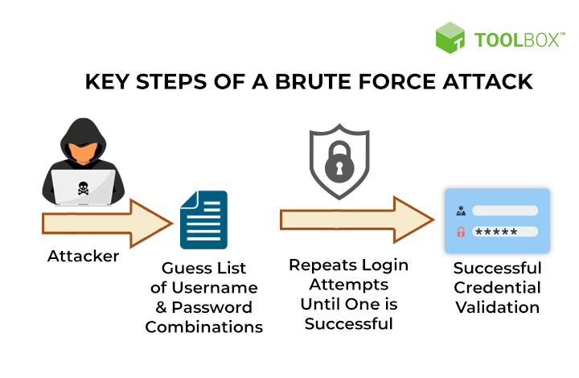
How Brute Force attack work?

Slide 7
AGENDA
What is Brute Force attack?
How Brute Force attack Works?
How to use Brute Force Attack?
Types of brute force attacks
How to detect Brute force Attack
How to prevent Brute Force attack?
Motives Behind Brute Force Attacks
Pros and Cons

Slide 8
How to use Brute force Attack
Tools
Aircrack-ng
L0phtCrack
Hashcat
Ncrack
THC-Hydra

Slide 9
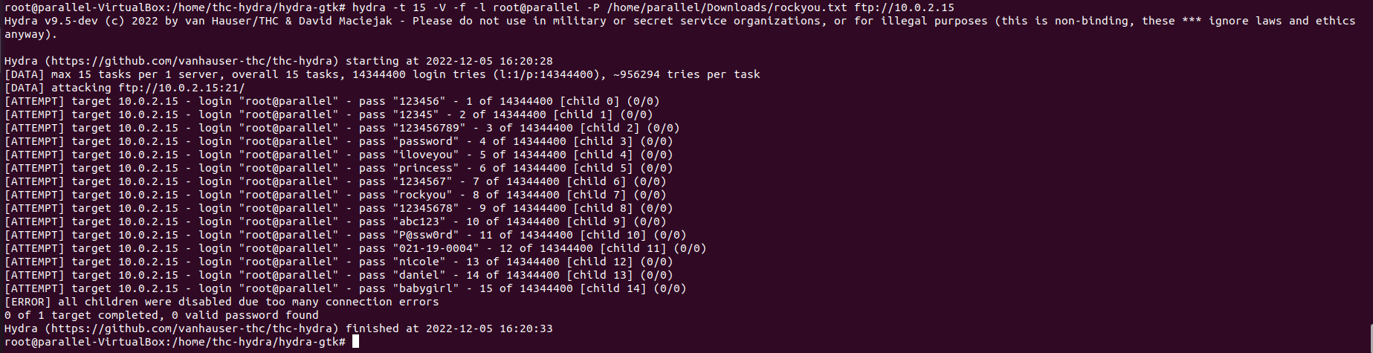
How to use Brute force Attack

Slide 10
How to use Brute force Attack
-t 15 is for number of tasks that can run parallel.
-f quits once you have found positive username and password match.
-l root@parallel use root@parallel as username to attempt to login
-p rockyou.txt :- this is the wordlist that we will be pulling passwords from.
ftp://10.0.2.15 this is the IP we want to attack.

Slide 11
AGENDA
What is Brute Force attack?
How Brute Force attack Works?
How to use Brute Force Attack?
Types of brute force attacks
How to detect Brute force Attack
How to prevent Brute Force attack?
Motives Behind Brute Force Attacks
Pros and Cons

Slide 12
Types of brute force attacks
Simple brute force attacks
An attacker tries to logically guess a password. They may try either common passwords or do minimal reconnaissance work to discover personal information, like your pet’s name. This attack can work with passwords like “password” or “pet123.”
2. Reverse brute force attack
Oftentimes, brute force attacks involve testing many passwords against a known username. In a reverse brute force attack, hackers test a common password like “123456” against a list of possible usernames.

Slide 13
AGENDA
What is Brute Force attack?
How Brute Force attack Works?
How to use Brute Force Attack?
Types of brute force attacks
How to detect Brute force Attack
How to prevent Brute Force attack?
Motives Behind Brute Force Attacks
Pros and Cons

Slide 14
How to Detect Brute Force Attacks
Monitor unsuccessful login attempts
If you see there have been many repeated failed login attempts, be suspicious
Failed login attempts from the same IP address into many accounts.
If you receive an email from your network service provider notifying you of a user from an unrecognized location logged into your system, immediately change all passwords and credentials.

Slide 15
AGENDA
What is Brute Force attack?
How Brute Force attack Works?
How to use Brute Force Attack?
Types of brute force attacks
How to detect Brute force Attack
How to prevent Brute Force attack?
Motives Behind Brute Force Attacks
Pros and Cons

Slide 16
How to prevent Brute Force attack
Common prevention methods:
While you are creating a password,
create a strong password.
Increase Password length
Increase password complexity (use alphanumeric password)
4. Enforce two-factor authentication

Slide 17
AGENDA
What is Brute Force attack?
How Brute Force attack Works?
How to use Brute Force Attack?
Types of brute force attacks
How to detect Brute force Attack
How to prevent Brute Force attack?
Motives Behind Brute Force Attacks
Pros and Cons

Slide 18
Motives Behind Brute Force Attacks
Steal sensitive data
Financial loss
Attack on systems for malicious purposes
Make websites unavailable
Blackmail and extortion
Reroute website traffic to commissioned ad sites
Reputational damage

Slide 19
AGENDA
What is Brute Force attack?
How Brute Force attack Works?
How to use Brute Force Attack?
Types of brute force attacks
How to detect Brute force Attack
How to prevent Brute Force attack?
Motives Behind Brute Force Attacks
Pros and Cons

Slide 20
Pros and Cons
PROS:
The benefit of a brute force attack is that the password will eventually be found, even if it is just a bunch of random characters.
A brute force attack is able to hack any password system and encryption key out there.
CONS:
On the other side, brute force attacks are exceedingly slow as they may have to perform every possible combination of characters before they achieve their target.
For example, a four-character password takes much longer than a three-character password, and a five-character password takes considerably longer than a four-character password in brute force.
Hardware Intensive: Consume lots of processing power.

Slide 21
Thankyou!

